Slide 1

Tutoring is bad
Gus Lipkin

Slide 2
Problem and Anecdote

Slide 3
Problem
The tutoring system at Florida Poly is bad
Tutors make their own schedules
There is not a tutor for every class
Tutoring sessions can become crowded

Slide 4
Anecdote

Slide 5


This is Gus taking stats 1

Slide 6


This is Gus one week before his midterm

Slide 7


This is Gus At tutoring Before the exam
Two Days
Eighteen hours
Six Days
Five Days
One week
Four Days
Three Days

Slide 8


This is Gus Asking Dr Bunn where the stats tutor has been

Slide 9

This is Gus taking a crash course in stats 1 from dr bunn

Slide 10


This is Gus Barely passing his exam

Slide 11
The state of tutoring today

Slide 12
Description
Some courses offer pre-scheduled group tutoring with tutors

Slide 13
The current tutoring model
Departments choose classes for tutoring
Departments hire tutors for those classes
Tutors set their availability
Departments schedule tutoring
Tutors are available for a specific class at a set time
Students choose to come in for tutoring

Slide 14
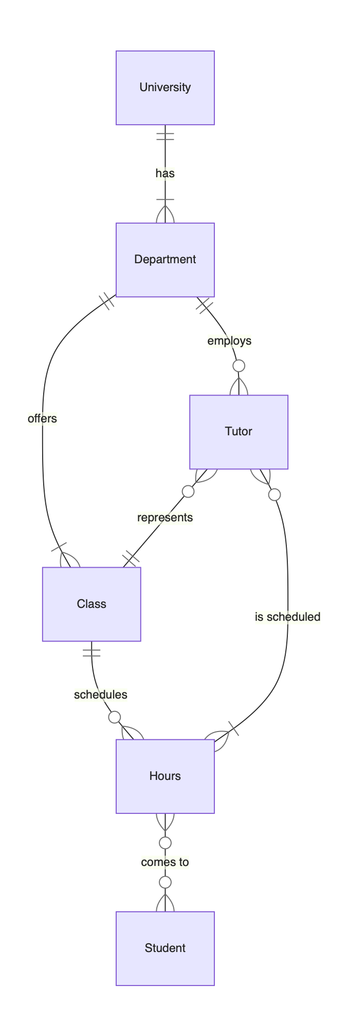
As an entity relationship diagram

Slide 15
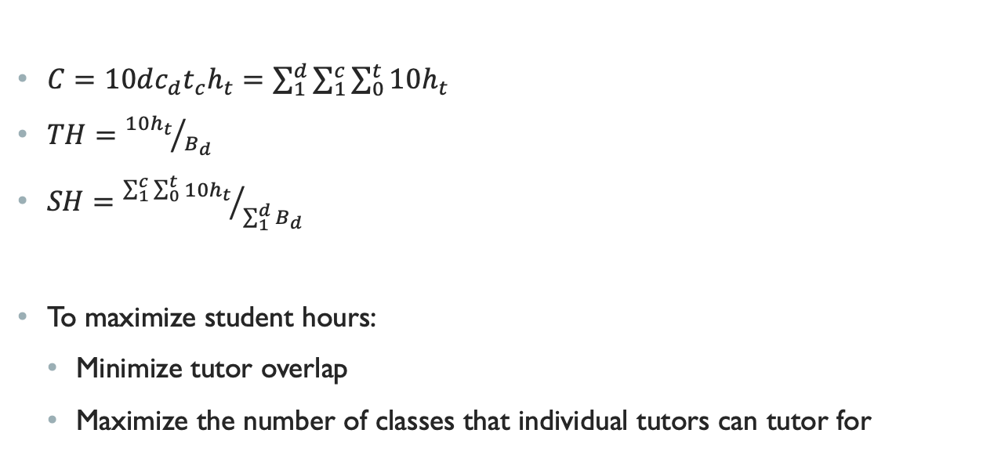
Icky Math
$C=10dc_{d}t_{c}h_{t}=\sum_{1}^{d}{\sum_{1}^{c}{\sum_{0}^{t}{10h_{t}}}}$
$TH={10h_{t}}/{B_{d}}$
$SH={\sum_{1}^{c}{\sum_{0}^{t}{10h_{t}}}}/{\sum_{1}^{d}{B_{d}}}$
To maximize student hours:
Minimize tutor overlap
Maximize the number of classes that individual tutors can tutor for

Slide 16
Possible alternatives

Slide 17
A One-on-one tutoring model

Slide 18
Description
Tutors are knowledgeable in a variety of subjects
Students book time with a tutor for a specific class

Slide 19
A one-on-one tutoring model
University
University
Class
Tutor
Department
Class
Tutor
Tutor
Hours
Student

Slide 20
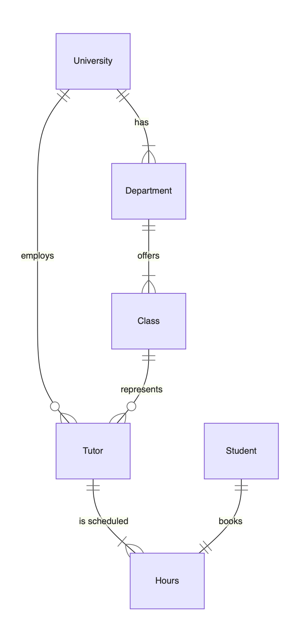
As an entity relationship diagram

Slide 21
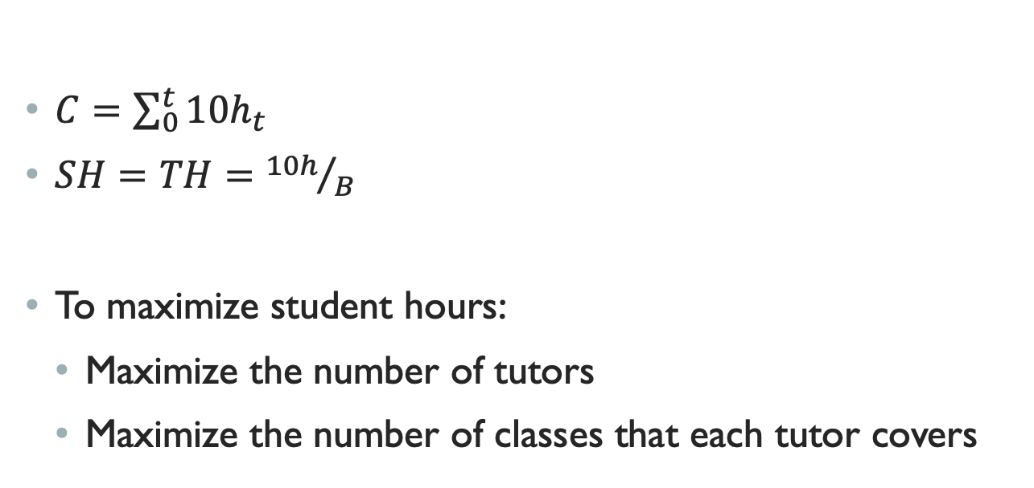
Icky Math
$C=\sum_{0}^{t}{10h_{t}}$
$SH=TH={10h}/B$
To maximize student hours:
Maximize the number of tutors
Maximize the number of classes that each tutor covers

Slide 22
A Hybrid tutoring model

Slide 23
Description
Combine a group tutoring and one-on-one tutoring model
For high demand courses, there are scheduled tutoring sessions
For high and low demand courses, students can schedule time with a tutor

Slide 24
A Hybrid tutoring model
I tried to make a flowchart but it’s just easier to show you the ERD

Slide 25
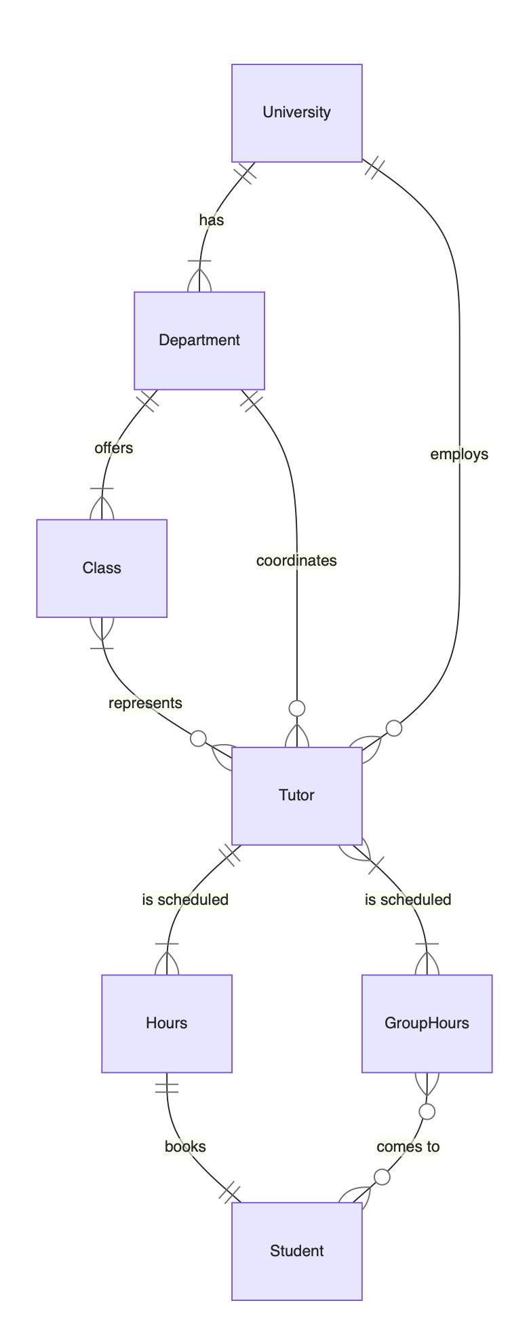
As an entity relationship diagram

Slide 26
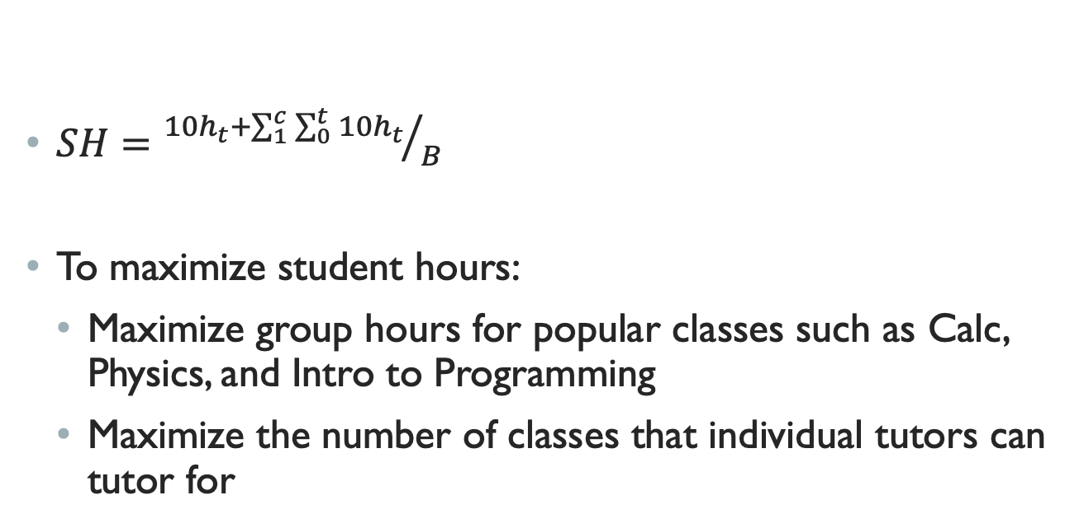
Icky Math
$SH={10h_{t}+\sum_{1}^{c}{\sum_{0}^{t}{10h_{t}}}}/B$
To maximize student hours:
Maximize group hours for popular classes such as Calc, Physics, and Intro to Programming
Maximize the number of classes that individual tutors can tutor for

Slide 27
Conclusions

Slide 28
This is a difficult problem to tackle
Without sufficient proof that working together will save money and help students, no departments will want to pool resources
I don’t know how to do enough of the theoretical math to convince anyone

Slide 29
A hybrid model is probably best
You get the best parts of group tutoring and one-on-one tutoring
It has potential to be at least as efficient as group tutoring

Slide 30


Questions for the audience

Slide 31
Kori
Who?

Slide 32
Hailey
What?

Slide 33
Logan
When?

Slide 34
Maverick
Where?

Slide 35
Dr Dewey
Why?

Slide 36
Nicole
How?

Slide 37
Jake
Can you find a number that does not follow this pattern?
If the number is even, divide it by two. If it’s odd, divide by three and add one
Repeat step one with your new number until you reach one

Slide 38





Hailey
Date?

Slide 39
Tutoring is bad
Gus Lipkin

